Slide 1
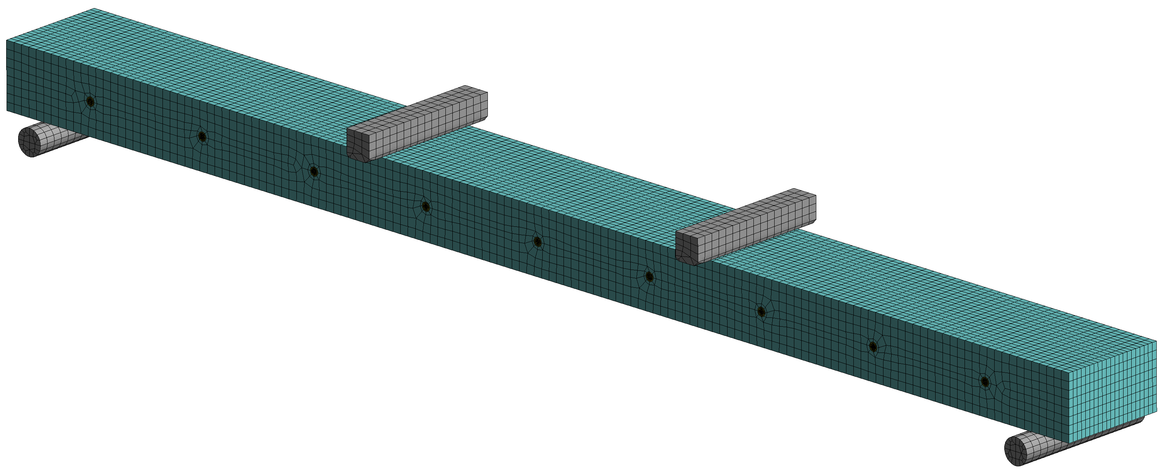
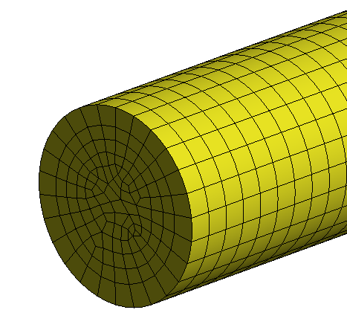
Loading plates
Fixed support
Sliding support
Detail of dowel mesh

Slide 2
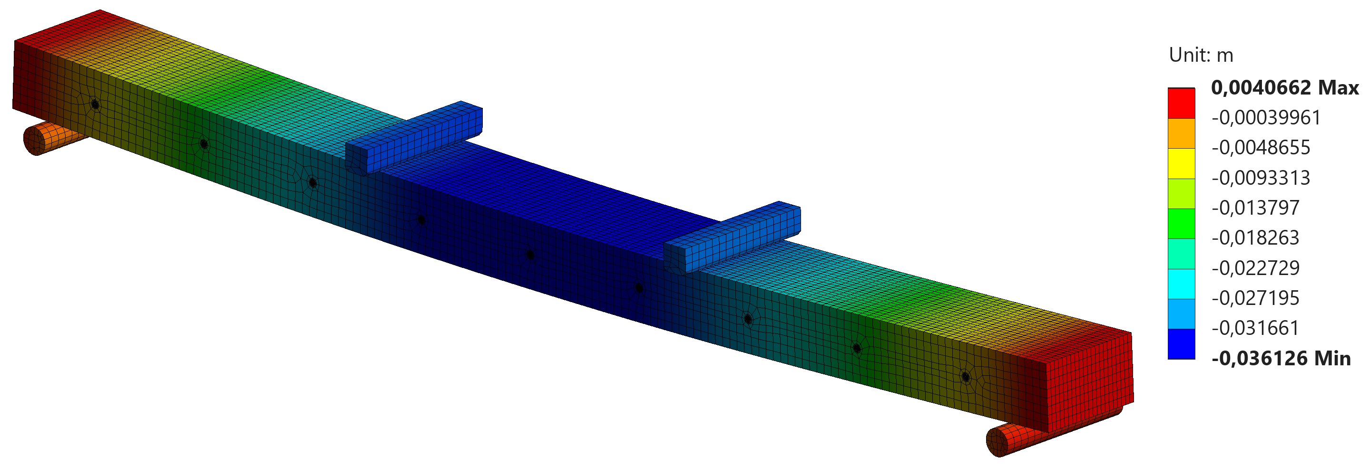
Vertical displacement in the bending test simulation considering 88 kN load.

Slide 3
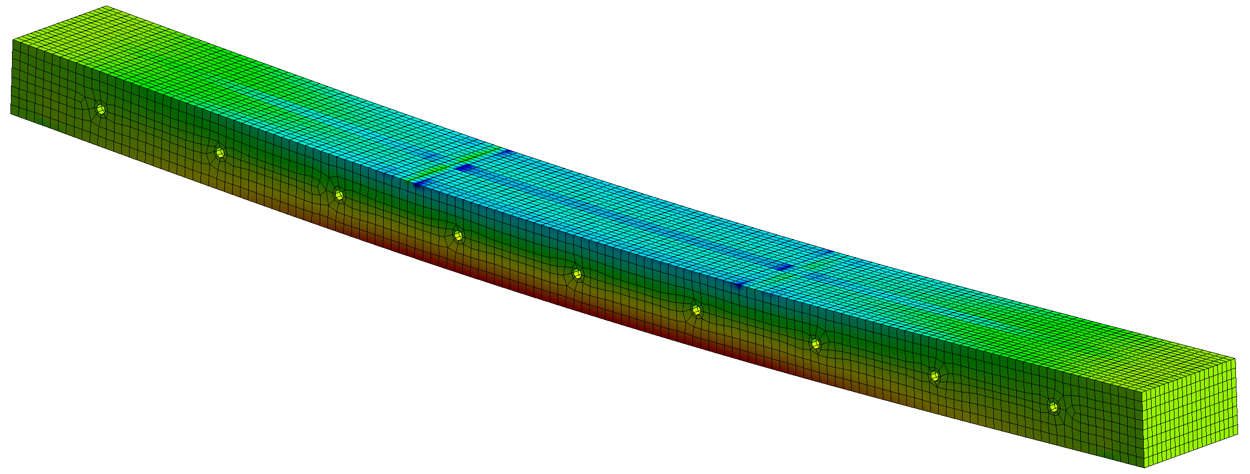
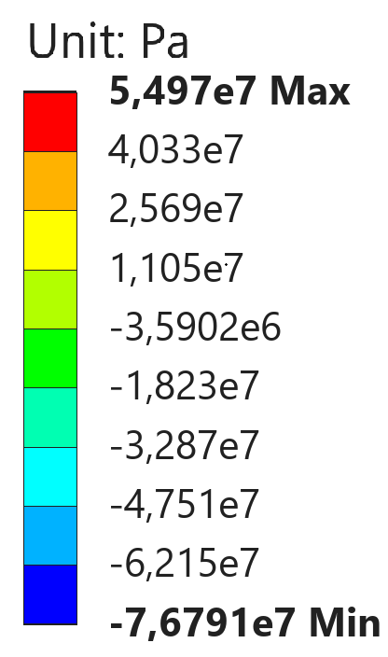
Tensile normal stress in the panel with a load of 88 kN
(a)
Board MOE 15.98 GPa (Tensile normal stress 54.97 MPa)
(b)
Board MOE 10.29 GPa (Tensile normal stress 35.38 MPa)
(c)

Slide 4
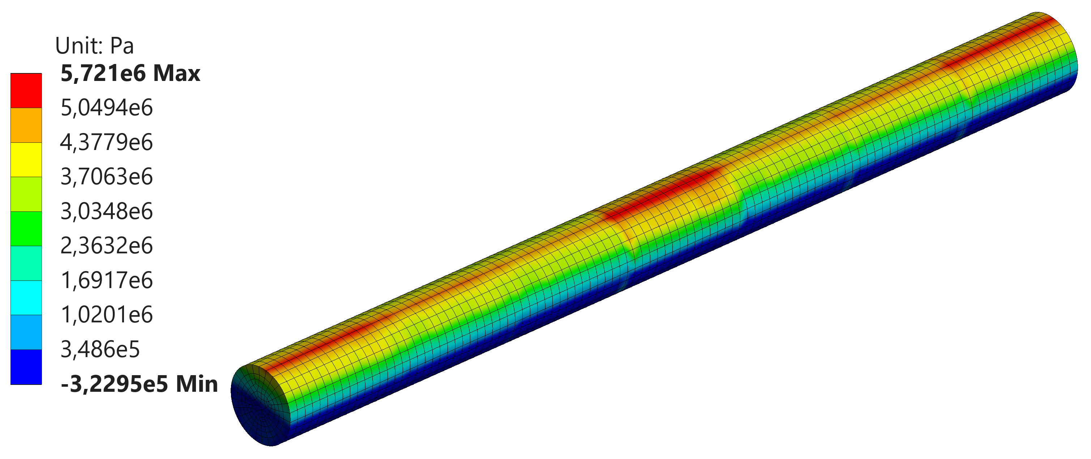

Slide 5
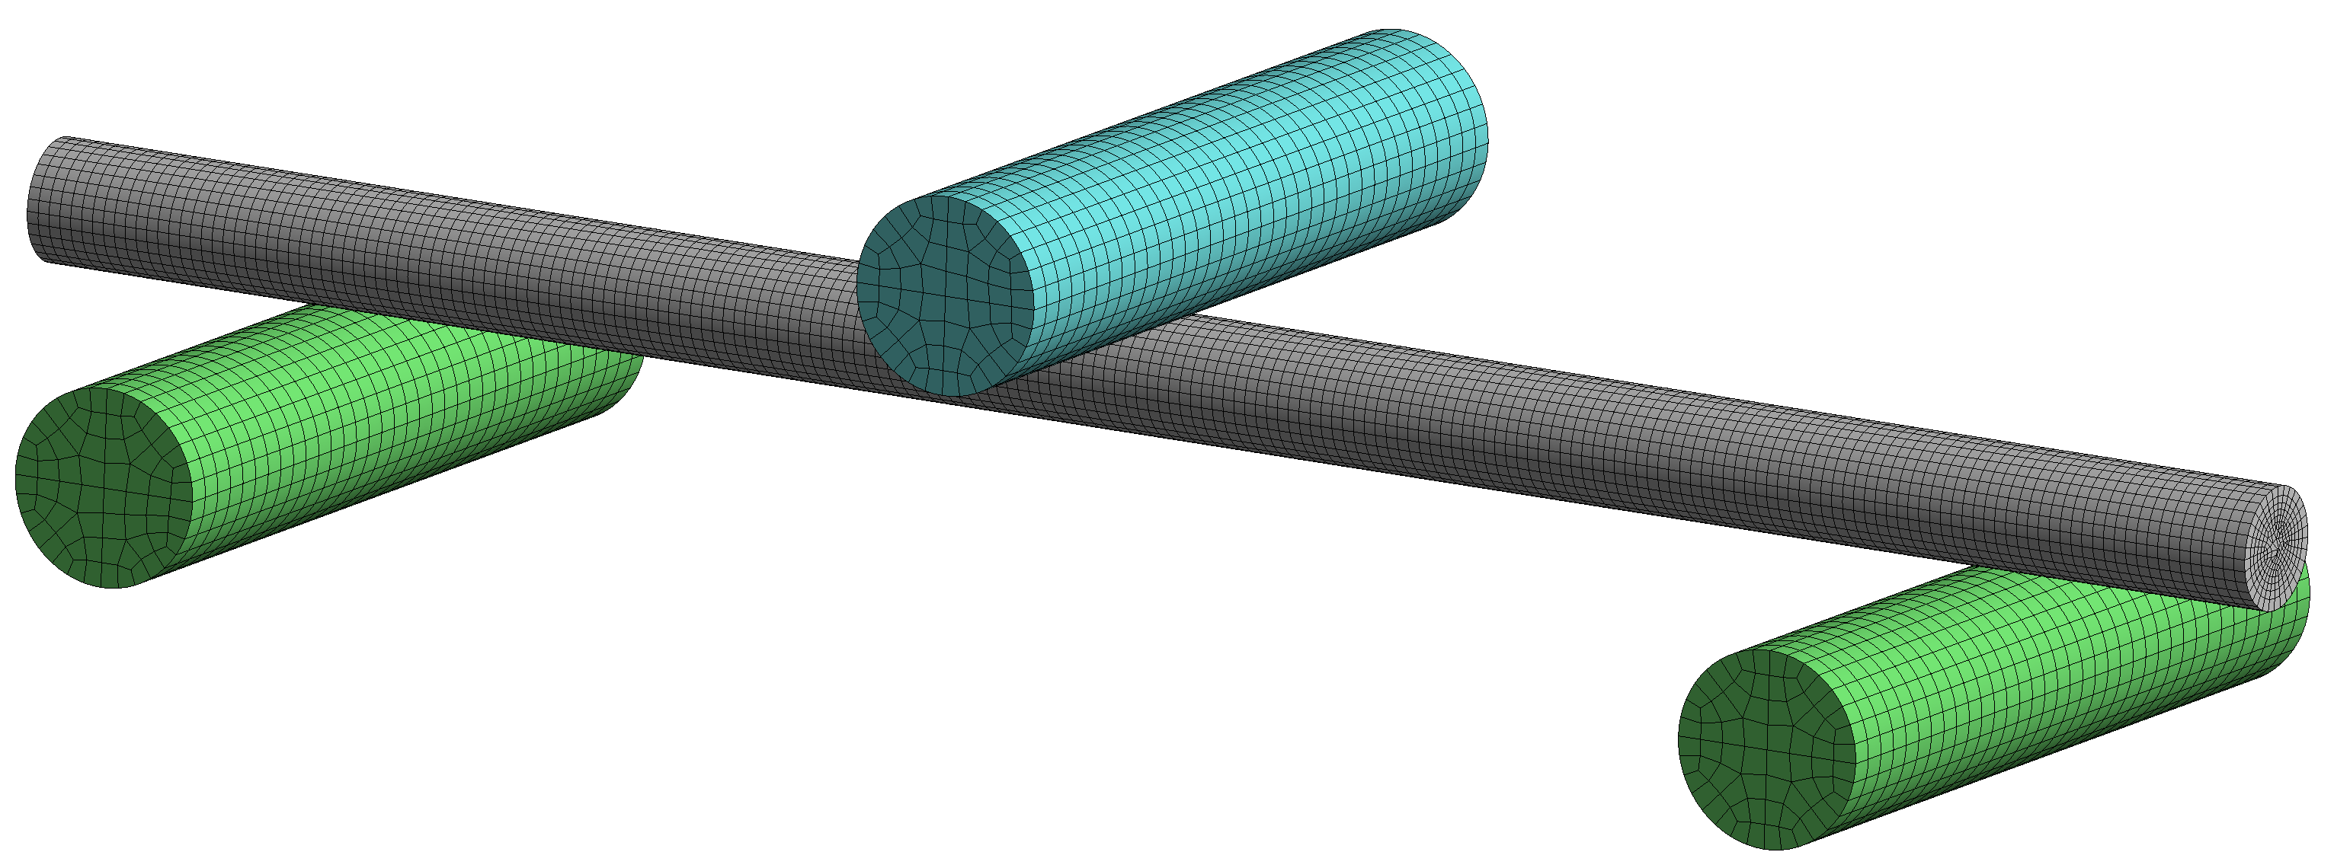
Loading support
Fixed support
Sliding support
(a)

Slide 6
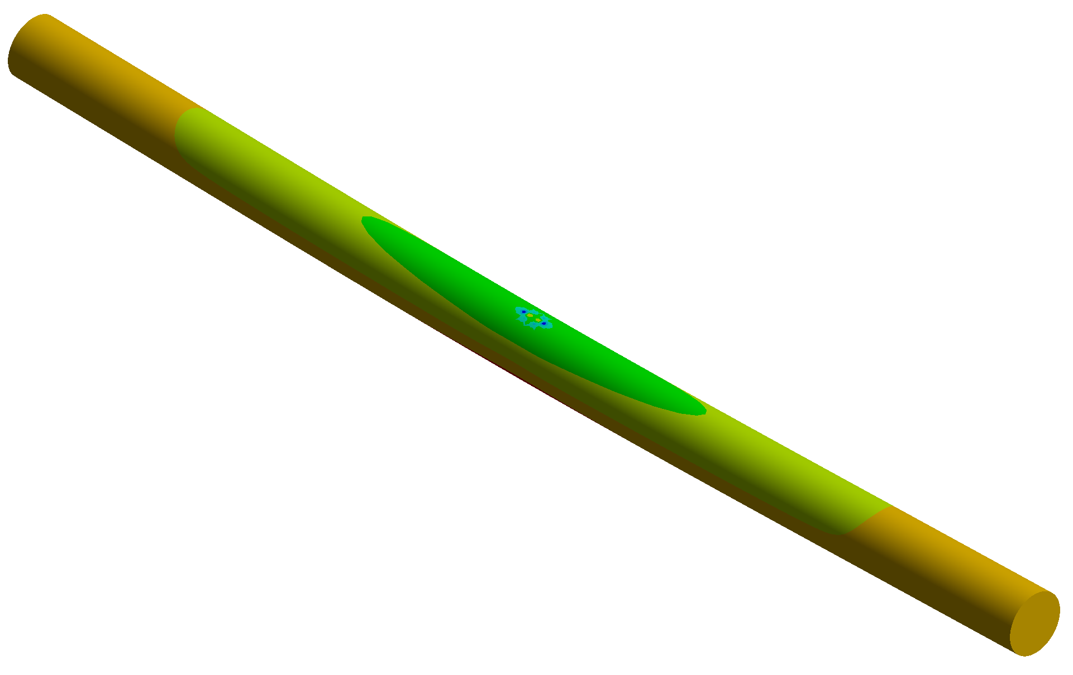
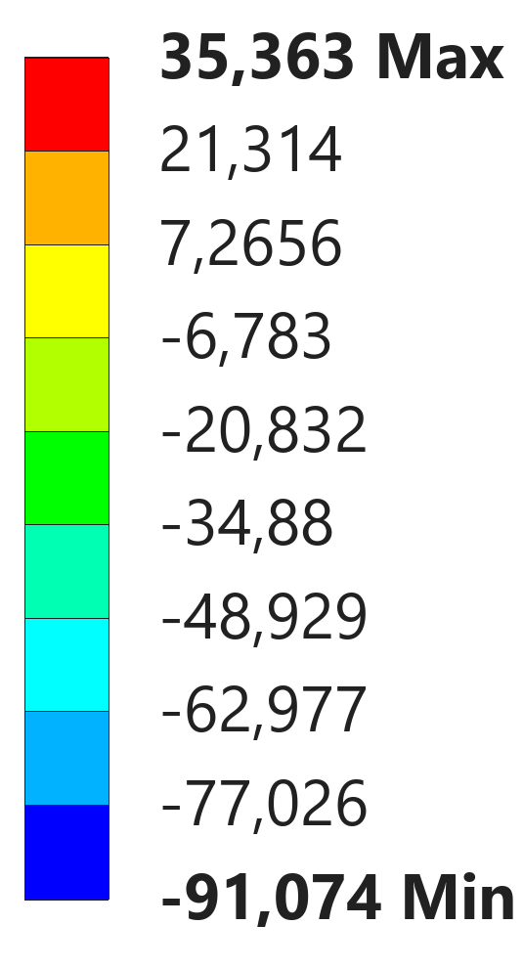
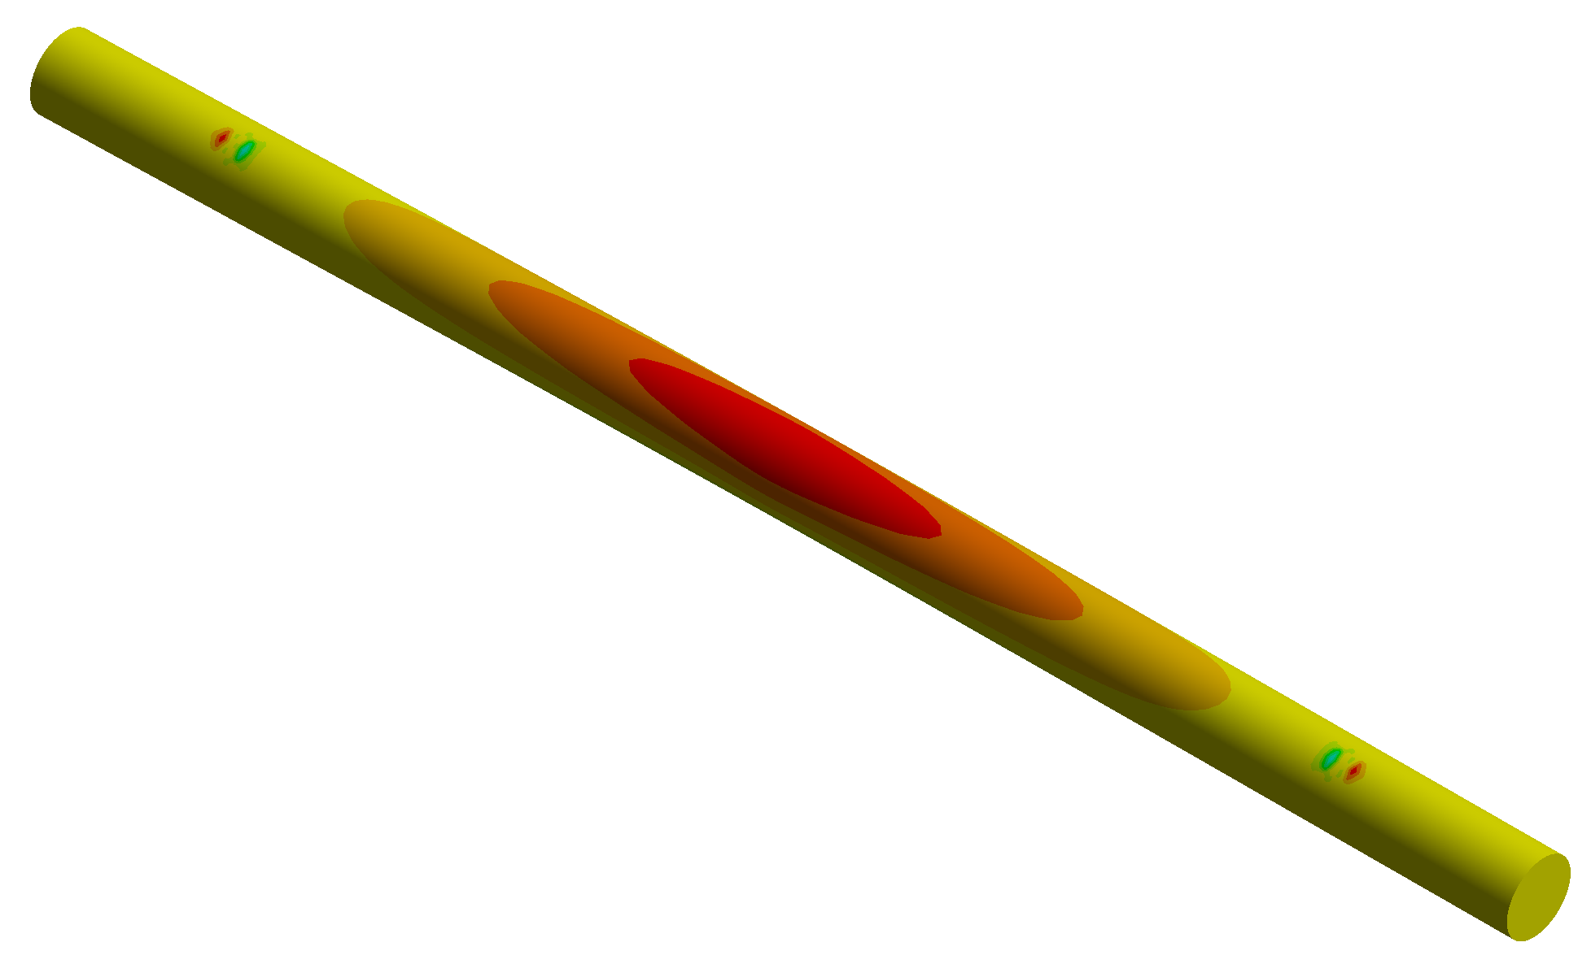
(c)
(b)

Slide 7
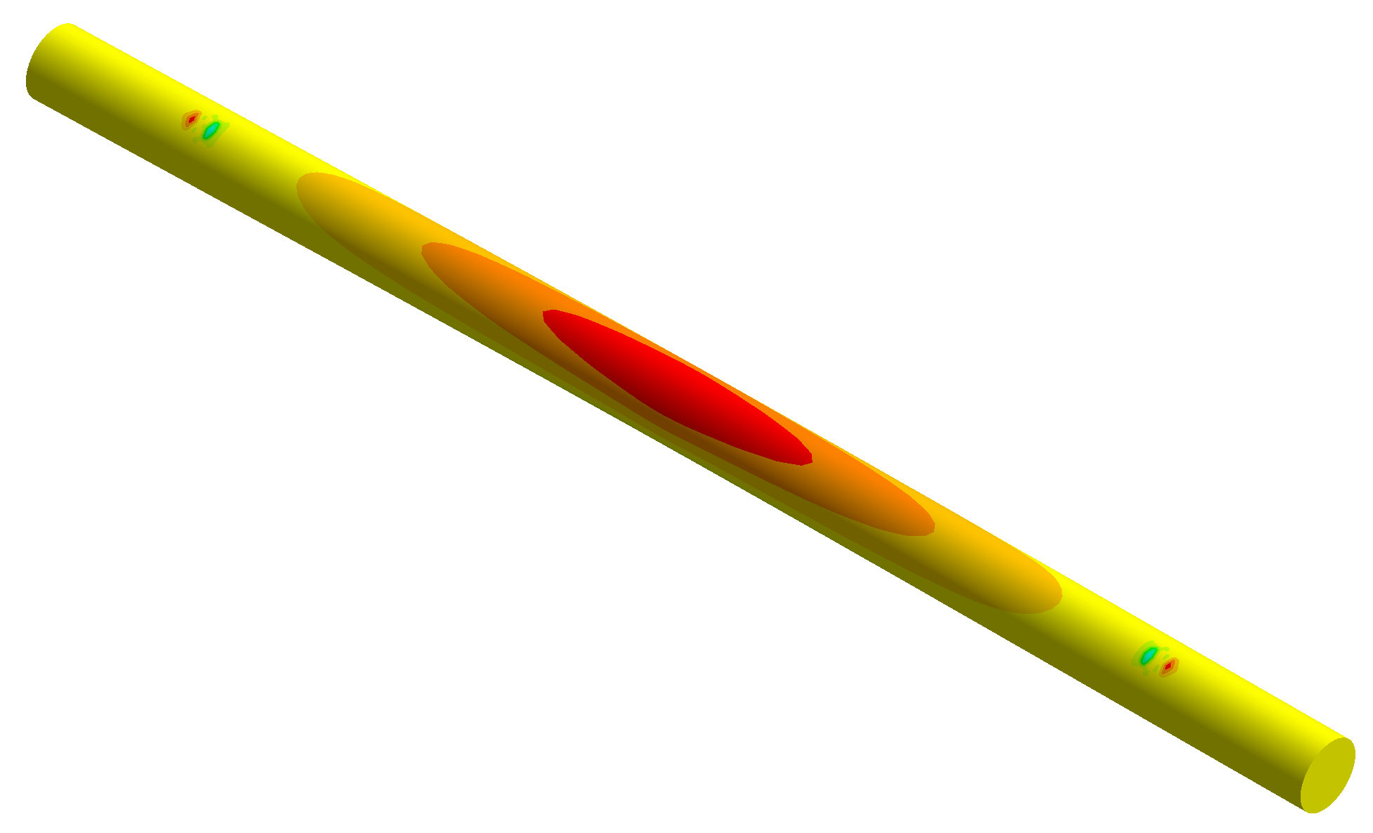
(b)

